Slide 1
Specification

Slide 2
Outline
Discussion of the term "specification"
Types of specifications
  operational
    Data Flow Diagrams
    (Some) UML diagrams
    Finite State Machines
    Petri Nets
  descriptive
    Entity Relationship Diagrams
    Logic-based notations
    Algebraic notations
Languages for modular specifications
  Statecharts
  Z

Slide 3
Specification
A broad term that means definition
Used at different stages of software development for different purposes
Generally, a statement of agreement (contract) between
  producer and consumer of a service
  implementer and user
All desirable qualities must be specified

Slide 4
Uses of specification
Statement of user requirements
  major failures occur because of misunderstandings between the producer and the user
  "The hardest single part of building a softwarem system is deciding precisely what to build" (F. Brooks)

Slide 5
Uses of specification (cont.)
Statement of the interface between the machine and the controlled environment
  serious undesirable effects can result due to misunderstandings between software engineers and domain experts about the phenomena affecting the control function to be implemented by software

Slide 6
Uses of specification (cont.)
Statement of requirements for implementation
  design process is a chain of specification (i.e., definition)–implementation–verification steps
    requirements specification refers to definition of external behavior
      design specification must be verified against it
    design specification refers to definition of the software architecture
      code must be verified against it

Slide 7
Uses of specification (cont.)
A reference point during maintenance
  corrective maintenance only changes implementation
  adaptive and perfective maintenance occur because of requirements changes
    requirements specification must change accordingly

Slide 8
Specification qualities
Precise, clear, unambiguous
Consistent
Complete
  internal completeness
  external completeness
Incremental

Slide 9
Clear, unambiguous, understandable
Example: specification fragment for a word-processor
Selecting is the process of designating
areas of the document that you want to
work on. Most editing and formatting
actions require two steps: first you
select what you want to work on,
such as text or graphics; then you
initiate the appropriate action.
can an area be scattered?

Slide 10
Precise, unambiguous, clear
Another example (from a real safety-critical system)
The message must be triplicated. The three
copies must be forwarded through three
different physical channels. The receiver
accepts the message on the basis of a
two-out-of-three voting policy.
can a message be accepted as soon as we receive 2 out of 3
identical copies of message or do we need to wait for
receipt of the 3rd?

Slide 11
Consistent
Example: specification fragment for a word-processor
The whole text should be kept in lines
of equal length. The length is specified
by the user. Unless the user gives an
explicit hyphenation command,
a carriage return should occur only
at the end of a word.
What if the length of a word exceeds the length of the line?

Slide 12
Complete
Internal completeness
  the specification must define any new concept or terminology that it uses
    glossary helpful for this purpose
  the specification must document all the needed requirements
    difficulty: when should one stop?

Slide 13
Incremental
Referring to the specification process
  start from a sketchy document and progressively add details
Referring to the specification document
  document is structured and can be understood in increments

Slide 14
Classification of specification styles
Informal, semi-formal, formal
Operational
  Behavior specification in terms of some abstract machine
Descriptive
  Behavior described in terms of properties

Slide 15
Example 1
Specification of a geometric figure E:
E can be drawn as follows:
1. Select two points P1 and P2 on a plane
2. Get a string of a certain length and fix its ends to P1 and P2
3. Position a pencil as shown in next figure
4. Move the pen clockwise, keeping the string tightly stretched, until you reach the point where you started drawing
this is an operational specification

Slide 16
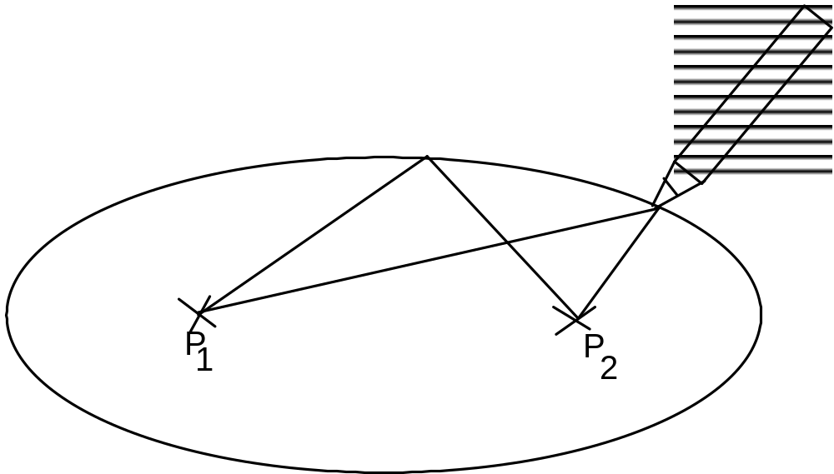

Slide 17
A descriptive specification
Geometric figure E is describe by the following equation
ax2 + by2 + c = 0
where a, b, and c are suitable constants

Slide 18
Another example
“Let a be an array of n elements. The result of its sorting is an array b of n elements such that the first element of b is the minimum of a (if several elements of a have the same value, any one of them is acceptable); the second element of b is the minimum of the array of n-1 elements obtained from a by removing its minimum element; and so on until all n elements of a have been removed.”
OP
“The result of sorting array a is an array b which is a permutation of a and is sorted.”
DES

Slide 19
How to verify a specification?
“Observe” dynamic behavior of specified system (simulation, prototyping, “testing” specs)
Analyze properties of the specified system
Analogy with traditional engineering
  physical model of a bridge
  mathematical model of a bridge

Slide 20
Data Flow Diagrams (DFDs)
A semi-formal operational specification
System viewed as collection of data manipulated by “functions”
Data can be persistent
  they are stored in data repositories
Data can flow
  they are represented by data flows
DFDs have a graphical notation

Slide 21
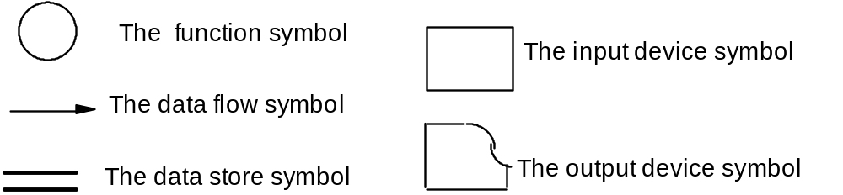
Graphical notation
  bubbles represent functions
  arcs represent data flows
  open boxes represent persistent store
  closed boxes represent I/O interaction

Slide 22
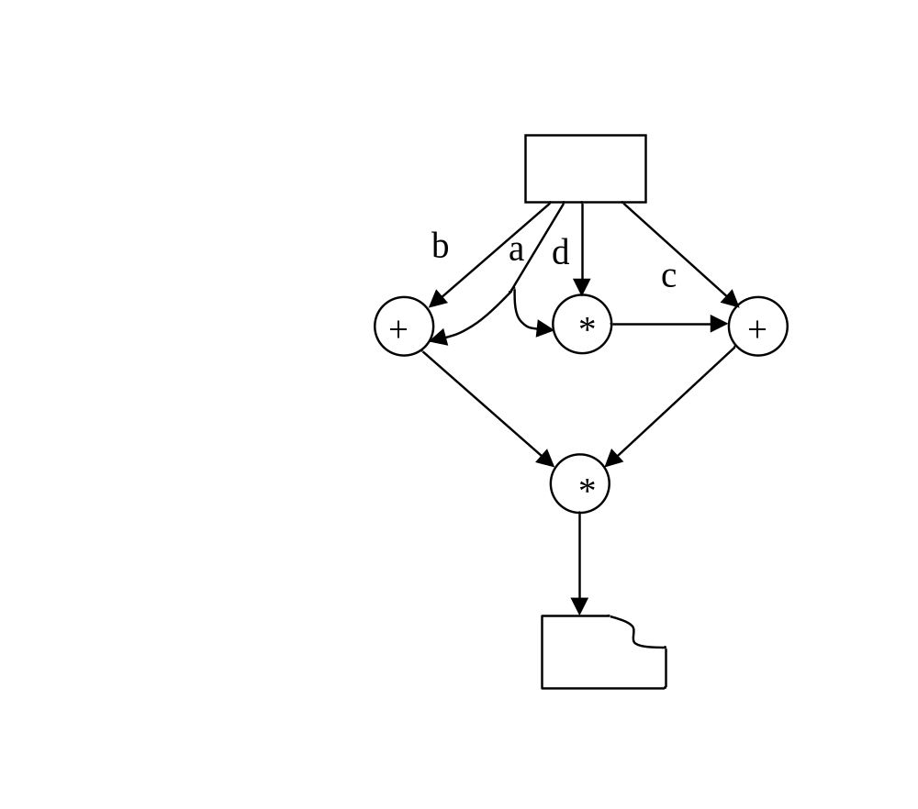
Example
specifies evaluation of
(a + b) * (c + a * d)

Slide 23
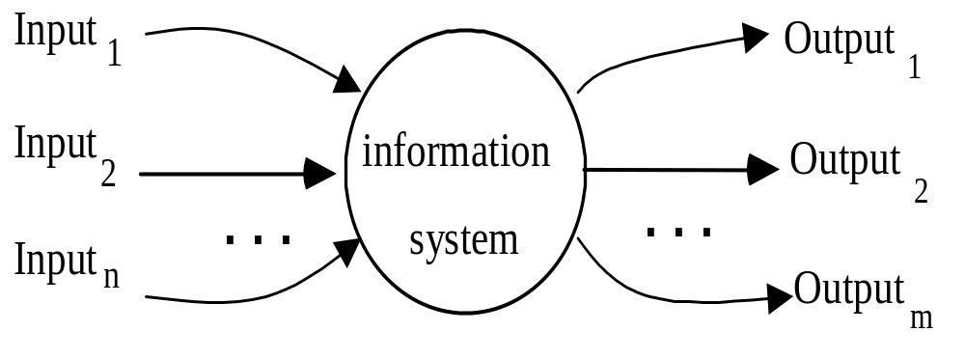
A construction “method” (1)
1. Start from the “context” diagram

Slide 24
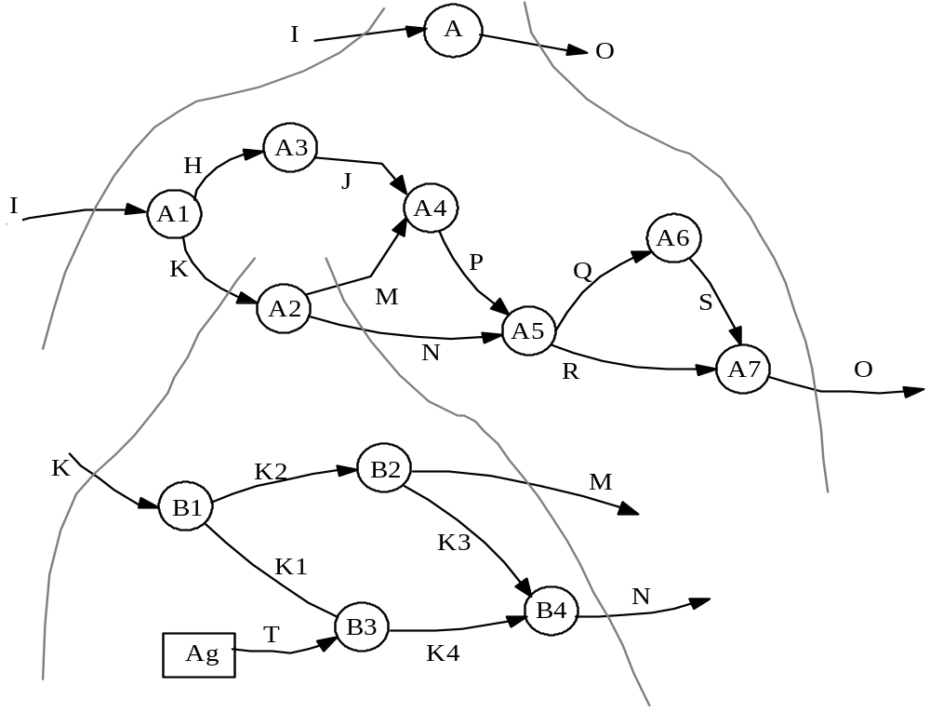
A construction “method” (2)
2. Proceed by refinements until you reach “elementary” functions (preserve balancing)

Slide 25
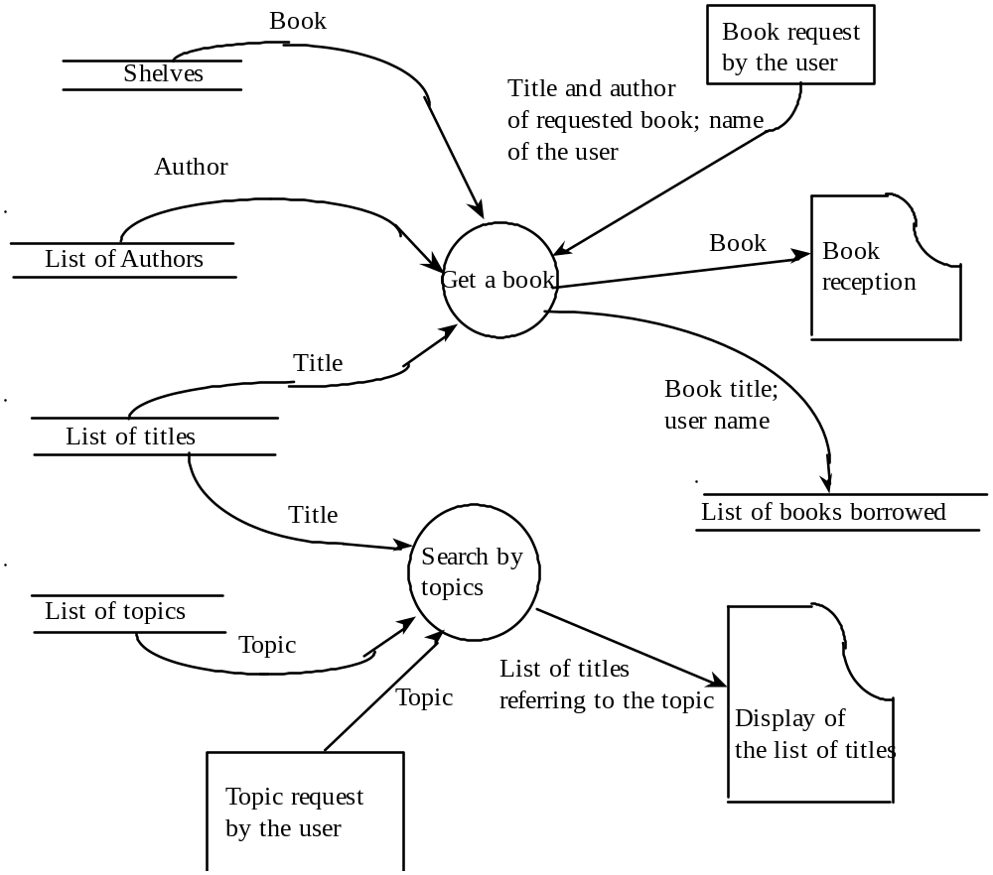
A library example

Slide 26
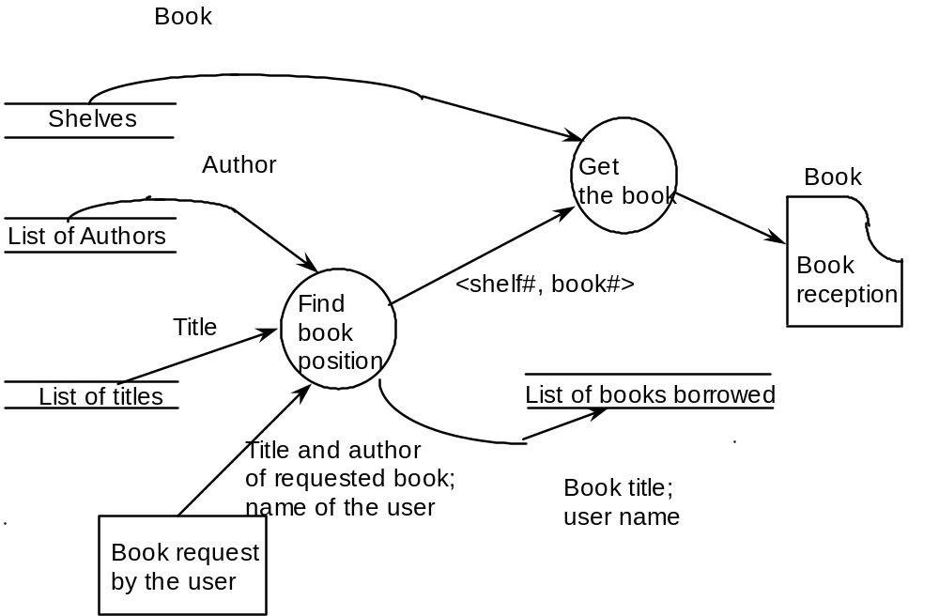
Refinement of
“Get a book”

Slide 27
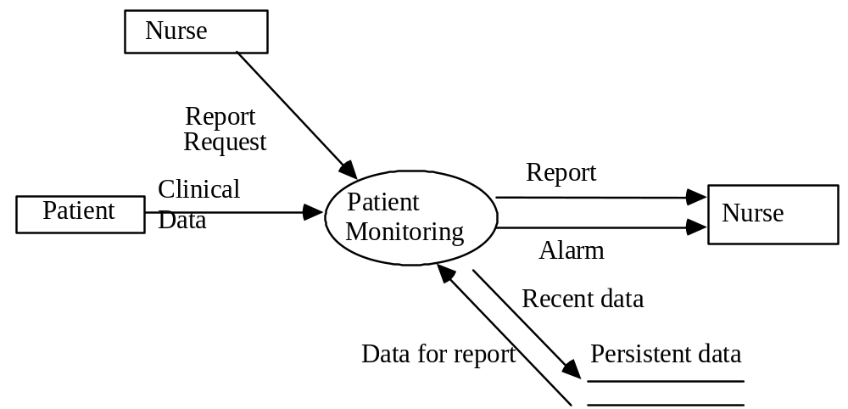
Patient monitoring systems
The purpose is to monitor the patients’ vital factors--blood,
pressure, temperature, …--reading them at specified frequencies
from analog devices and storing readings in a DB. If readings fall
outside the range specified for patient or device fails an alarm
must be sent to a nurse. The system also provides reports.

Slide 28
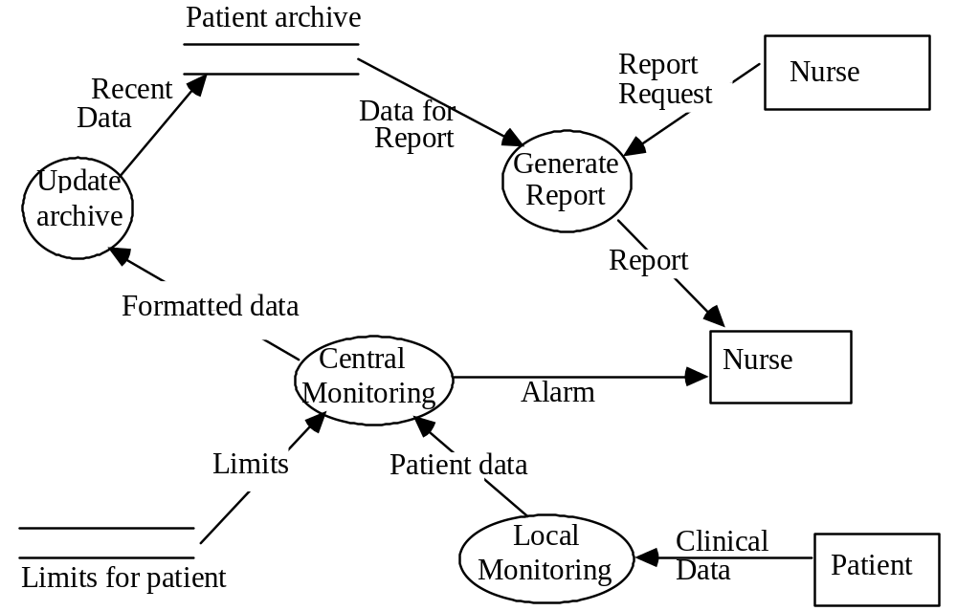
A refinement

Slide 29
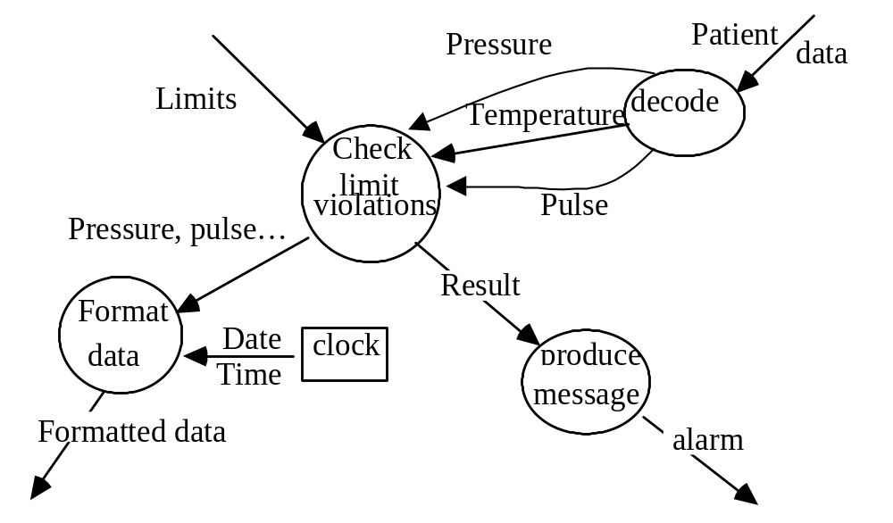
More refinement

Slide 30
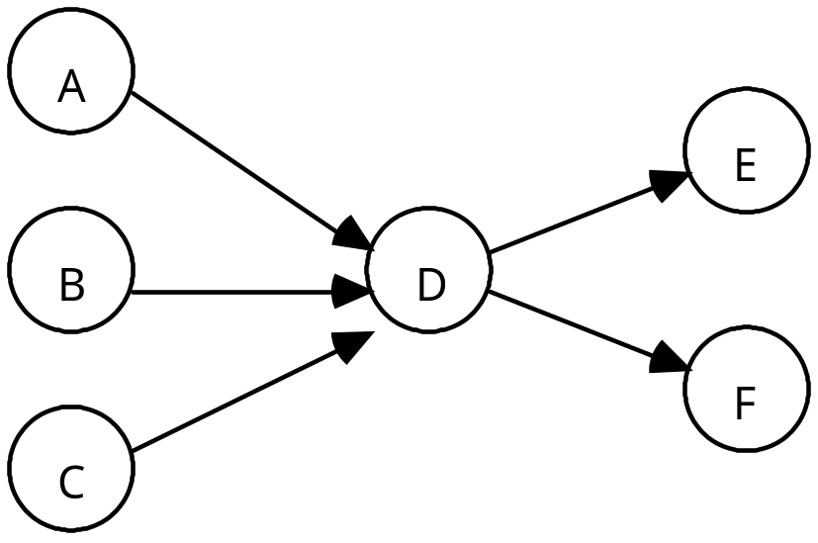
An evaluation of DFDs (1)
Easy to read, but …
Informal semantics
  How to define leaf functions?
  Inherent ambiguities
Outputs from A, B, C are
all needed?
Outputs for E and F are
produced at the same time?

Slide 31
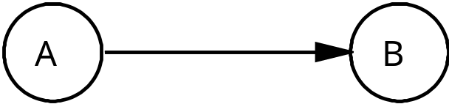
An evaluation of DFDs (2)
Control information is absent
Possible interpretations:
(a) A produces datum, waits until B consumes it
(b) B can read the datum many times without
consuming it
(c) a pipe is inserted between A and B

Slide 32
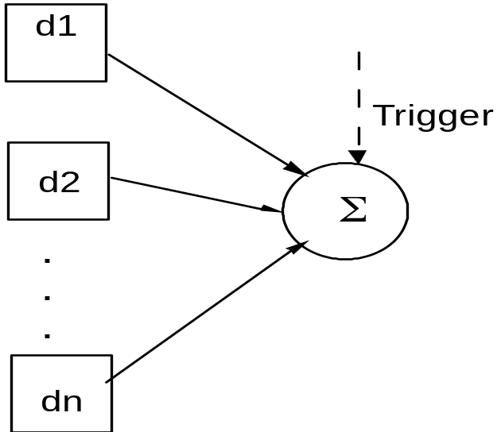
Formalization/extensions
There have been attempts to formalize DFDs
There have been attempts to extend DFDs (e.g., for real-time systems)

Slide 33
UML use-case diagrams
Define functions on basis of actors and actions
borrow
book
return
book
librarian
customer
library
update

Slide 34
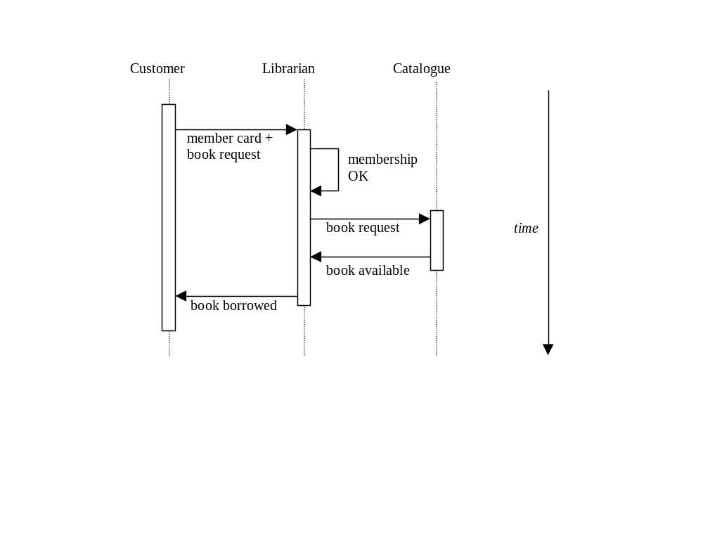
UML sequence diagrams
Describe how objects interact by exchanging messages
Provide a dynamic view

Slide 35
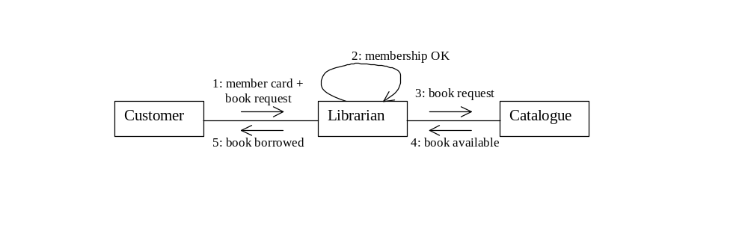
UML collaboration diagrams
Give object interactions and their order
Equivalent to sequence diagrams

Slide 36
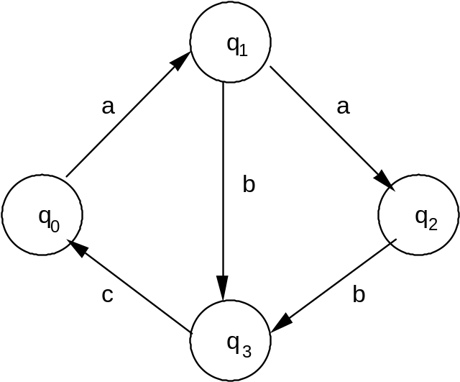
Finite state machines (FSMs)
Can specify control flow aspects
Defined as
a finite set of states, Q;
a finite set of inputs, I;
a transition function d : Q x I → Q
(d can be a partial function)

Slide 37
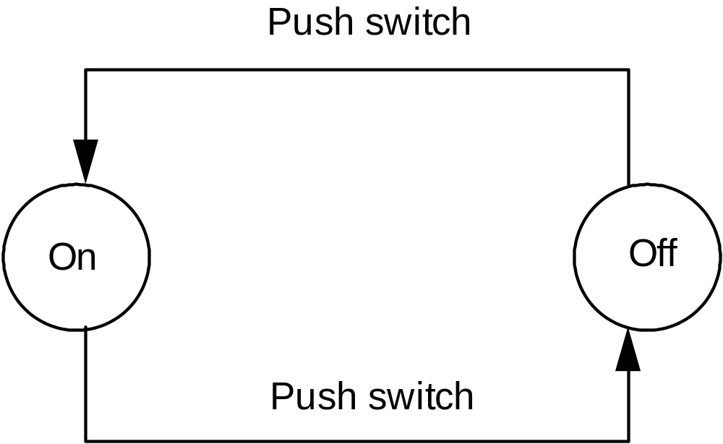
Example: a lamp

Slide 38
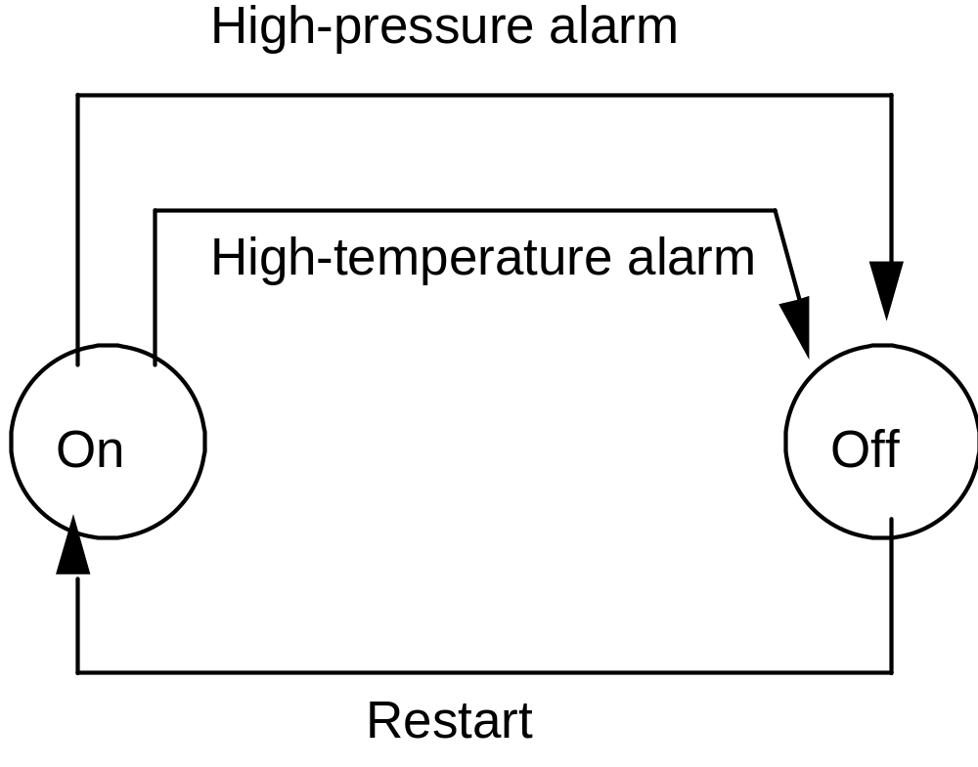
Another example: a plant control system

Slide 39
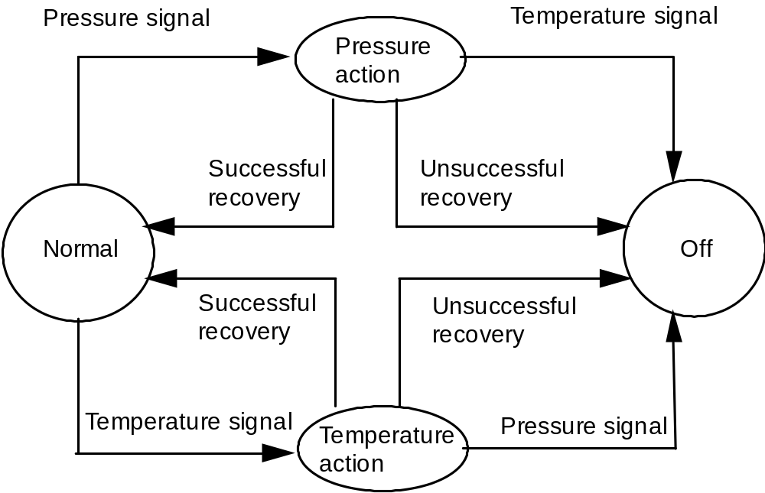
A refinement

Slide 40
Classes of FSMs
Deterministic/nondeterministic
FSMs as recognizers
  introduce final states
FSMs as transducers
  introduce set of outputs
. . .

Slide 41
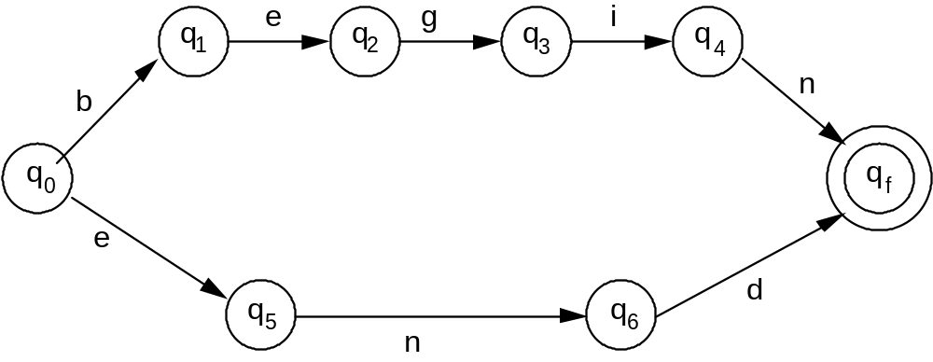
FSMs as recognizers
q_{f} is a final state

Slide 42
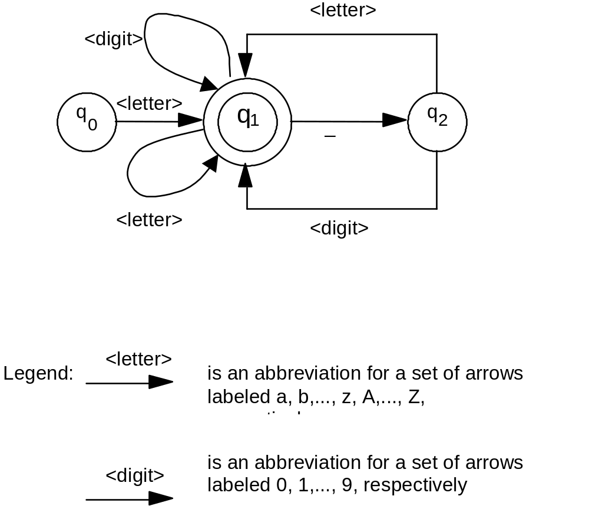
FSMs as recognizers

Slide 43
Limitations
Finite memory
State explosion
  Given a number of FSMs with k₁, k₂, … k_{n} states, their composition is a FSM with k₁ * k₂ *… * k_{n.} This growth is exponential with the number of FSMs, not linear (we would like it to be k₁ + k₂ +… + k_{n} )

Slide 44
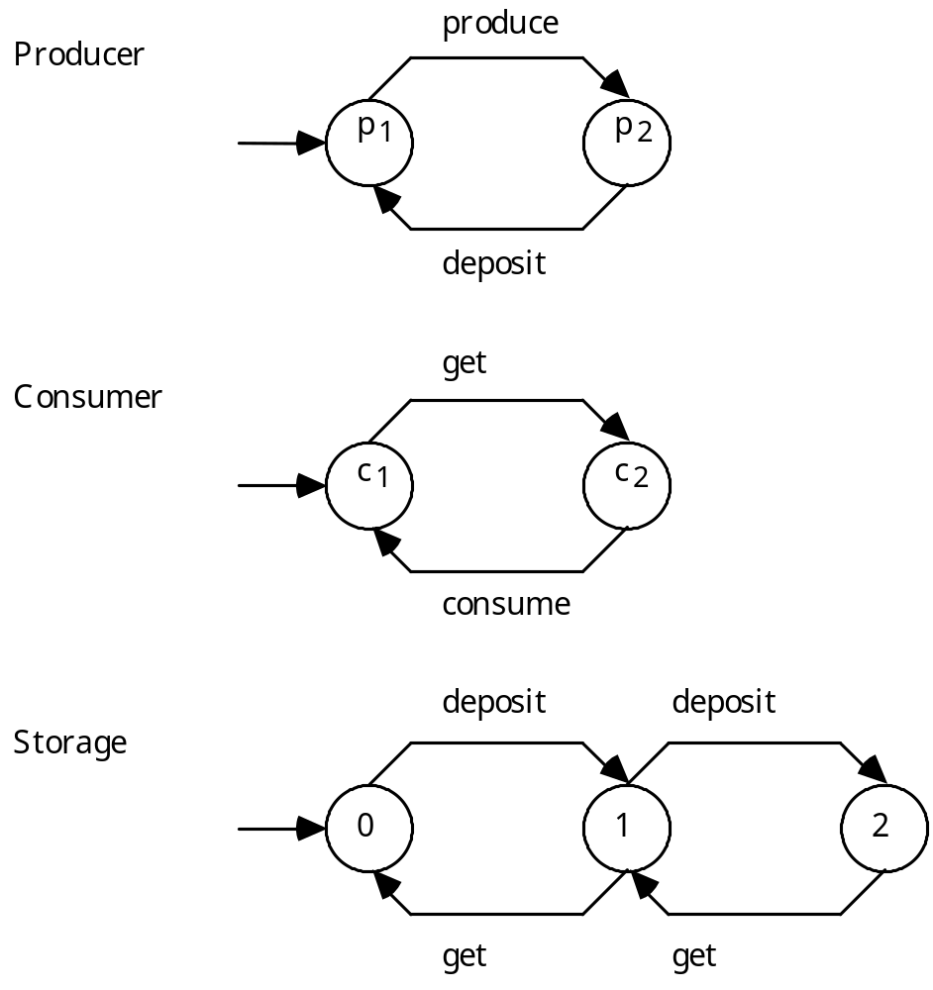
State explosion: an example

Slide 45
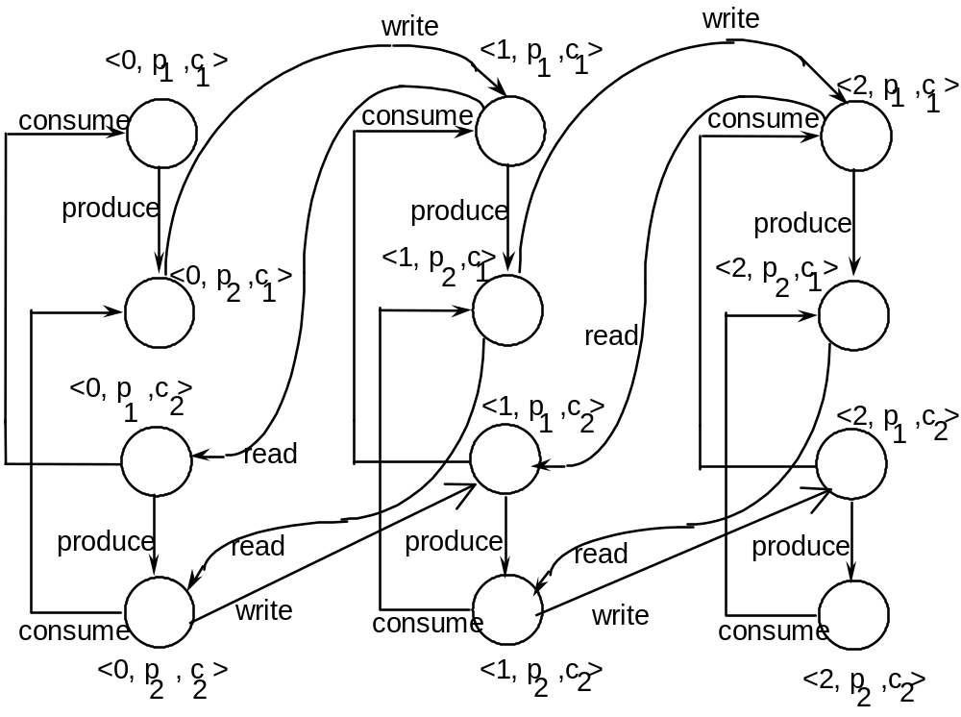
The resulting FSM

Slide 46
Petri nets
A quadruple (P,T,F,W)
P: places T: transitions (P, T are finite)
F: flow relation (F ⊆ {P×T} ∪ {T×P} ) W: weight function (W: F → N – {0} )
Properties:
(1) P ∩ T = Ø
(2) P ∪ T ≠ Ø
(3)F ⊆ (P × T) ∪ (T × P)
(4) W: F → N-{0}
Default value of W is 1
State defined by marking: M: P → N

Slide 47
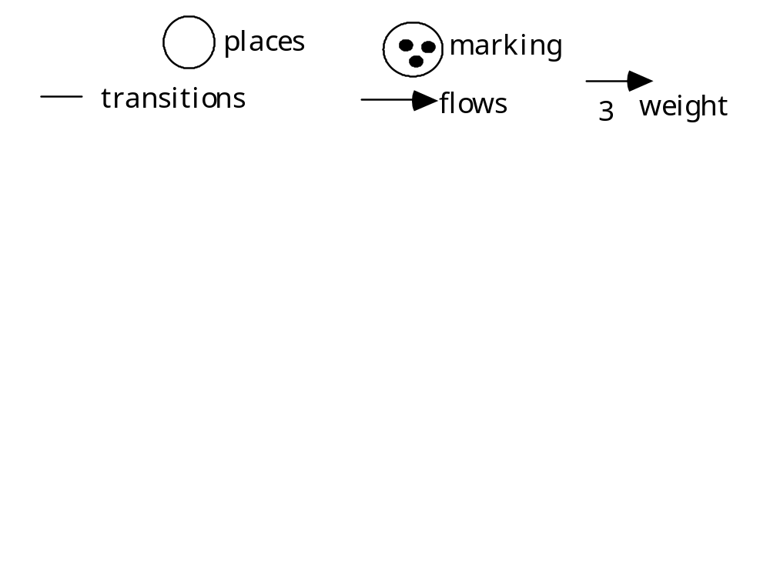
Graphical representation
P
1
P
2
t
1
P
t
3
2
P
4
P
5
t
4
t
3
P
6
P
t
7
5
t
6

Slide 48
Semantics: dynamic evolution
Transition t is enabled iff
  ∀p ∈ t's input places, M(p) ≥ W(<p,t>)
t fires: produces a new marking M’ in places that are either t's input or output places or both
  if p is an input place: M'(p) = M(p) - W(<p,t>)
  if p is an output place: M'(p) = M(p) + W(<t,p>)
  if p is both an input and an output place: M'(p) = M(p) - W(<p,t>) + W(<t,p>)

Slide 49
Nondeterminism
Any of the enabled transitions may fire
Model does not specify which fires, nor when it fires

Slide 50
Modeling with Petri nets
Places represent distributed states
Transitions represent actions or events that may occur when system is in a certain state
They can occur as certain conditions hold on the states

Slide 51
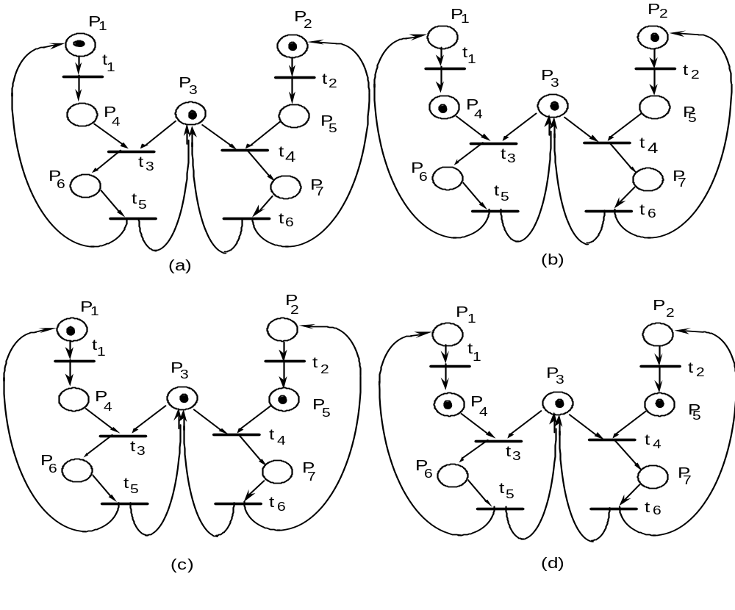
after (a) either (b) or (c) may occur, and then (d)

Slide 52
Common cases
Concurrency
  two transitions are enabled to fire in a given state, and the firing of one does nor prevent the other from firing
    see t₁ and t₂ in case (a)
Conflict
  two transitions are enabled to fire in a given state, but the firing of one prevents the other from firing
    see t₃ and t₄ in case (d)
    place P₃ models a shared resource between two processes
  no policy exists to resolve conflicts (known as unfair scheduling)
  a process may never get a resource (starvation)

Slide 53
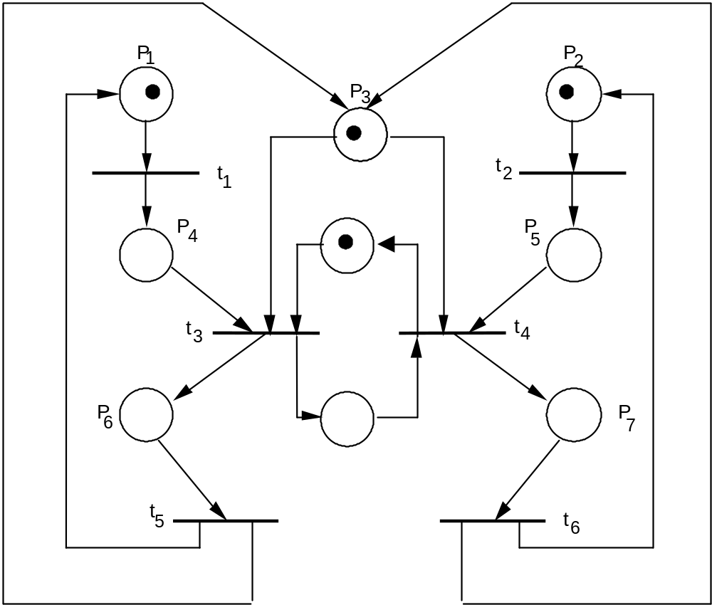
How to avoid starvation
imposes alternation

Slide 54
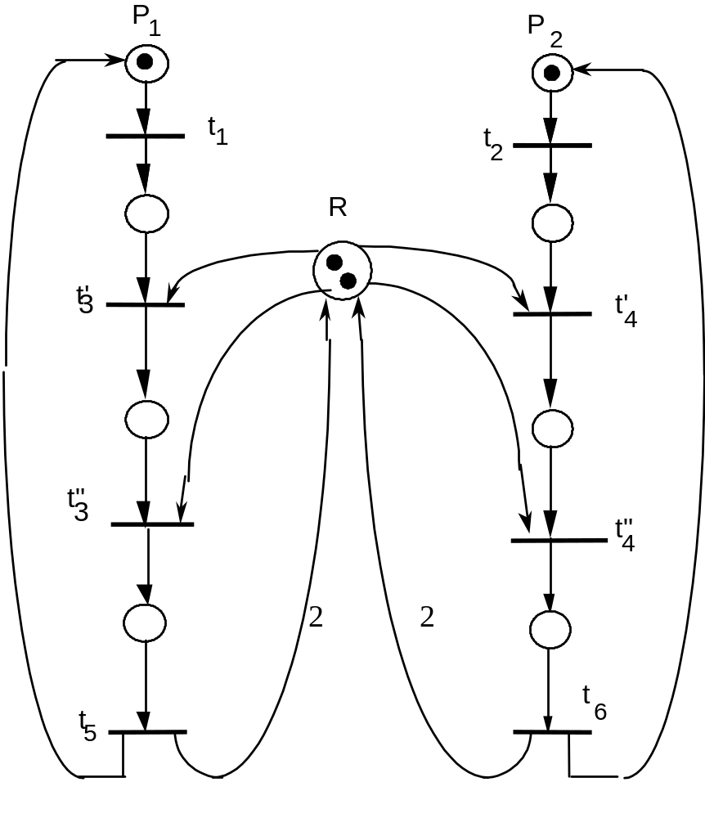

A conflict-free net
this net can
deadlock!
consider

Slide 55
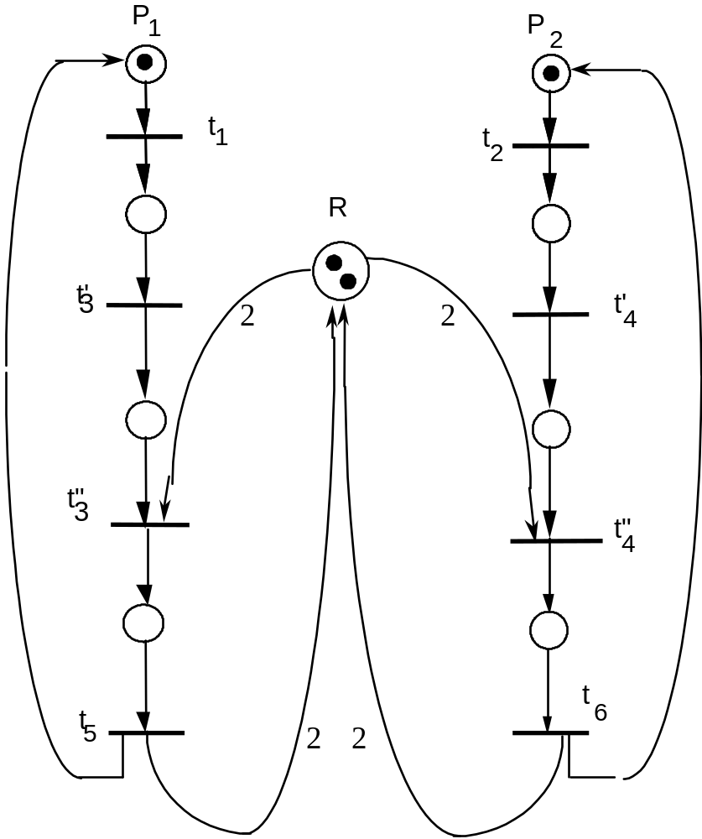
A deadlock-free net

Slide 56
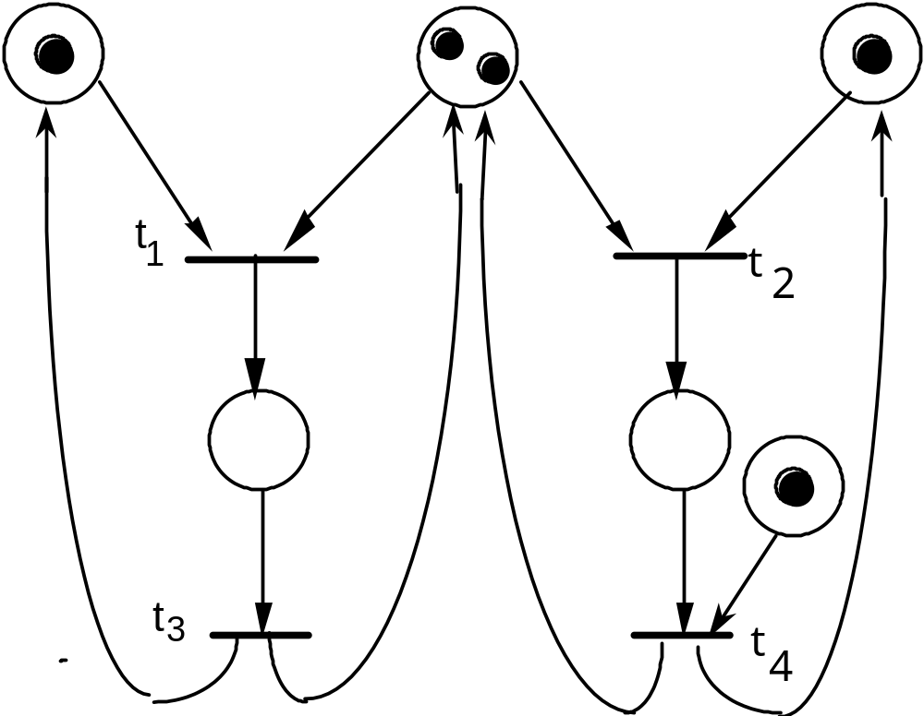
A case of partial starvation

Slide 57
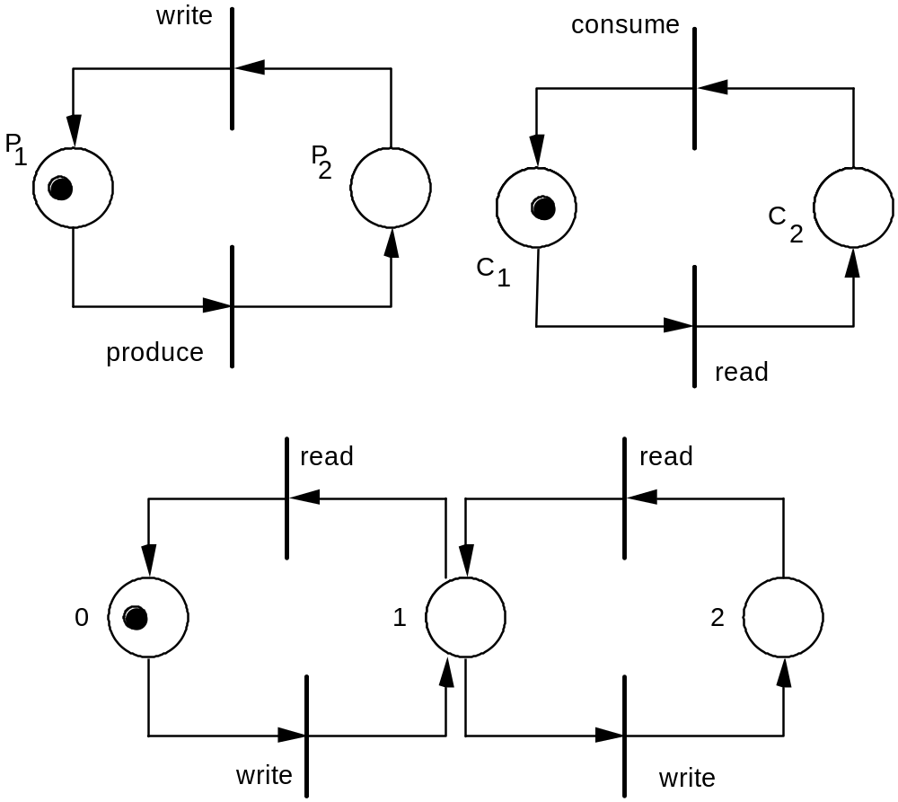
Producer-consumer example (1)
separate nets
for the subsystems

Slide 58
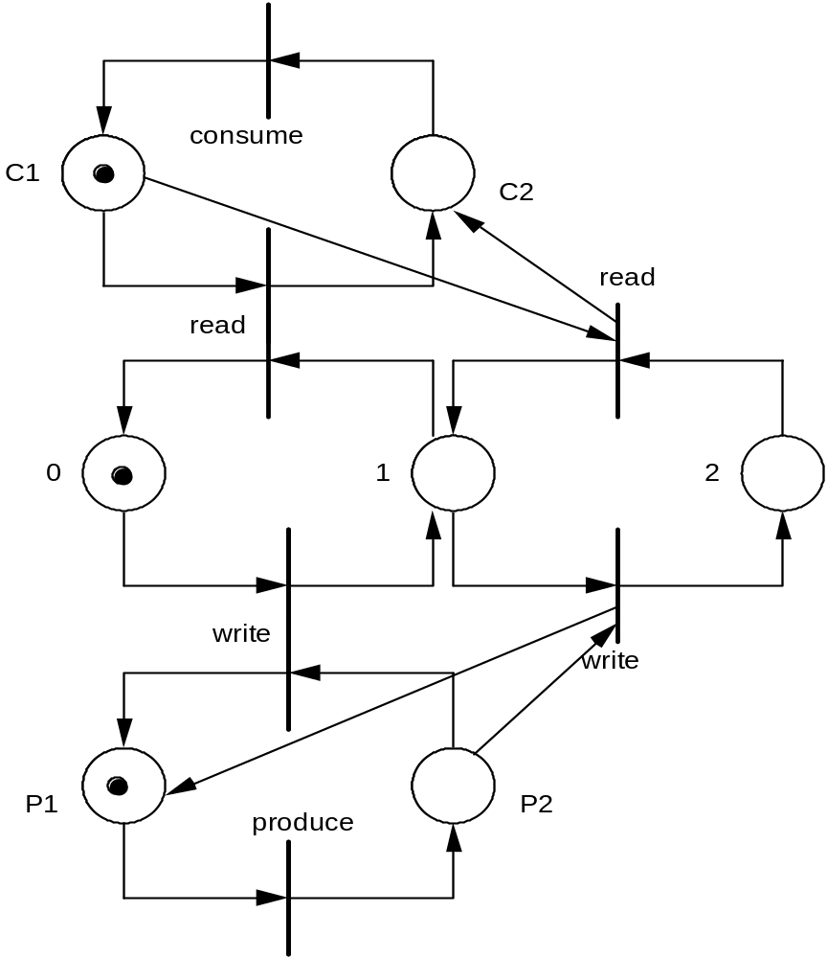
Producer-consumer example (2)
one net for the
entire system

Slide 59
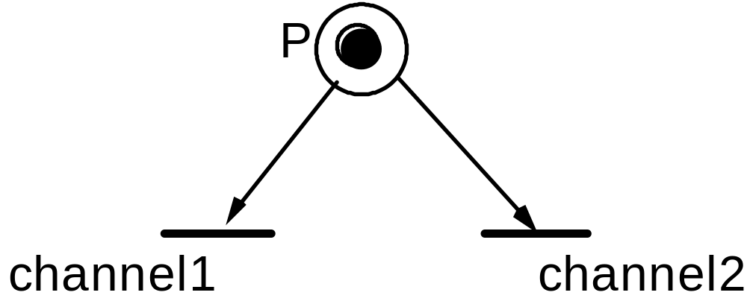
Limitations and extensions
Token represents a message.
You wish to say that the delivery channel depends
on contents.
How?
Petri nets cannot specify selection policies.

Slide 60
Extension 1 assigning values to tokens
Transitions have associated predicates and functions
Predicate refers to values of tokens in input places selected for firing
Functions define values of tokens produced in output places

Slide 61
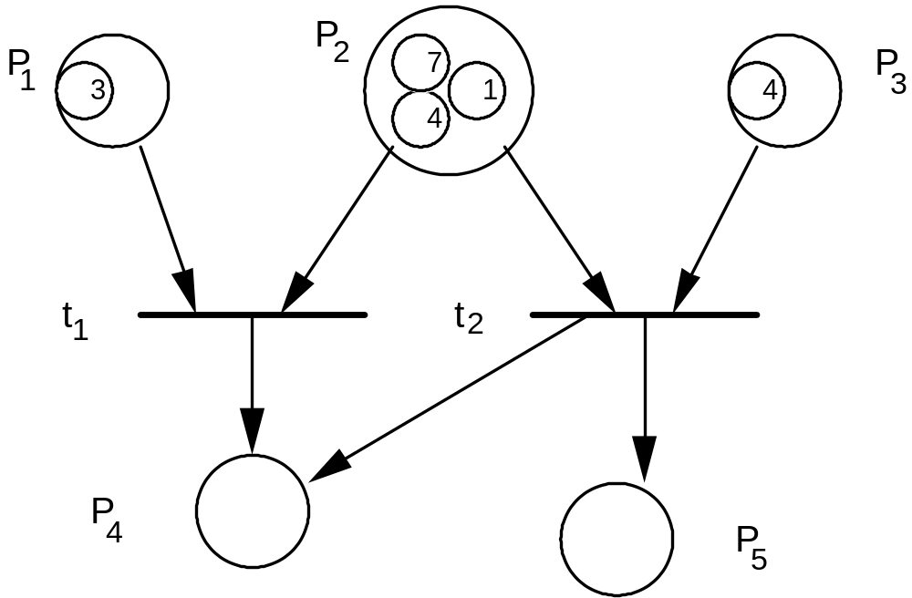
Example
Predicate P2 > P1
and function
P4 := P2 + P1
associated with t1
Predicate P3 = P2
and functions
P4 := P3 ⁻ P2 and
P5 := P2 + P3 are
associated with t2
The firing of t1 by using <3,7> would produce the
value 10 in P4. t2 can then fire using <4, 4>

Slide 62
Extension 2 specifying priorities
A priority function pri from transitions to natural numbers:
pri: T → N
When several transitions are enabled, only the ones with maximum priority are allowed to fire
Among them, the one to fire is chosen nondeterministically

Slide 63
Extension 3
Timed Petri nets
A pair of constants <tmin, tmax> is associated with each transition
Once a transition is enabled, it must wait for at least tmin to elapse before it can fire
If enabled, it must fire before tmax has elapsed, unless it is disabled by the firing of another transition before tmax

Slide 64
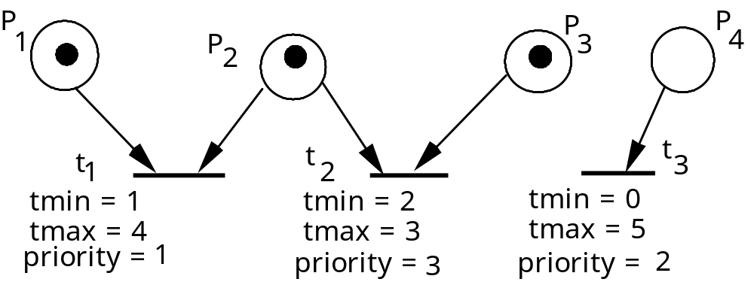
Example combining priorities and time

Slide 65
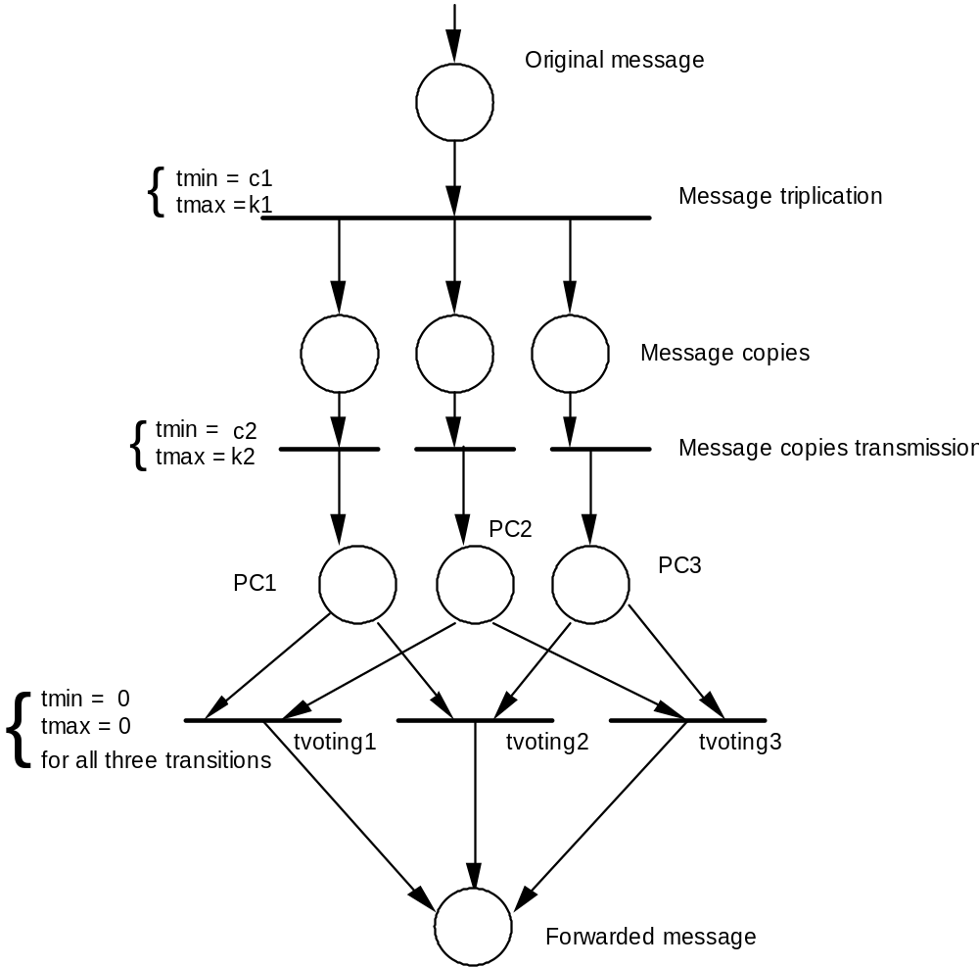
Precise specification
of message triplication
problem
Case (1)

Slide 66
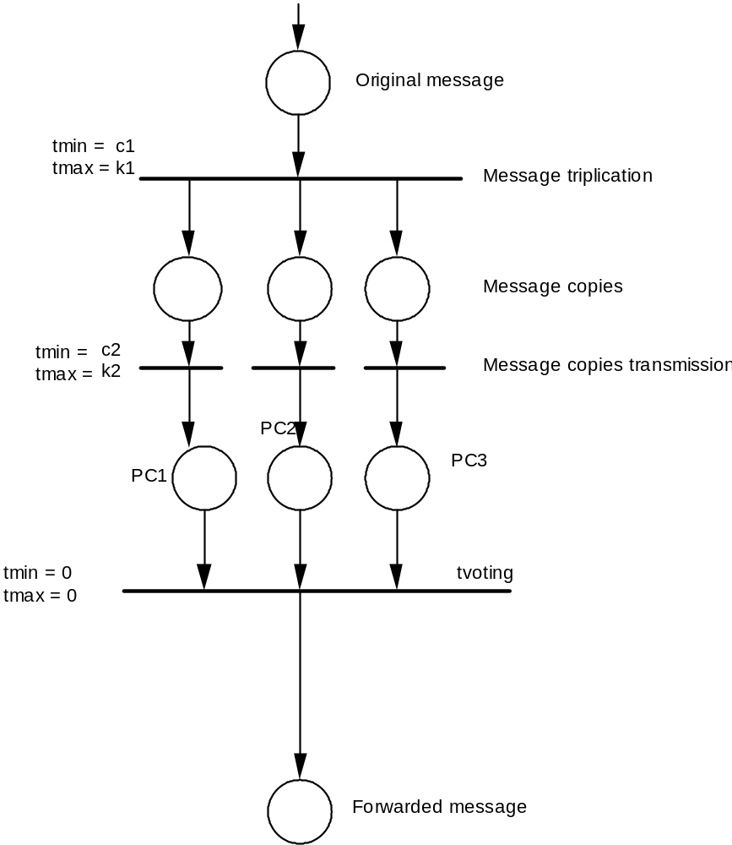
Precise specification
of message triplication
problem
Case (2)

Slide 67
Case study
An n elevator system to be installed in a building with m floors
Natural language specs contain several ambiguities
Formal specification using PNs removes ambiguities
Specification will be provided in a stepwise fashion
Will use modules, each encapsulating fragments of PNs which describe certain system components

Slide 68
From informal specs…
“The illumination is cancelled when the elevator visits the floor and is either moving in the desired direction, or ...”
2 different interpretations (case of up call)
  switch off as the elevator arrives at the floor from below (obvious restrictions for 1st and last floor)
  switch off after the elevators starts moving up
    in practice you may observe the two cases!

Slide 69
…more analysis of informal specs
“The algorithm to decide which to service first should minimize the waiting time for both requests.”
what does this mean?
    in no other way can you satisfy either request in a shorter time
      but minimizing for one may require longer for the other
    the sum of both is minimal
      why the sum?

Slide 70
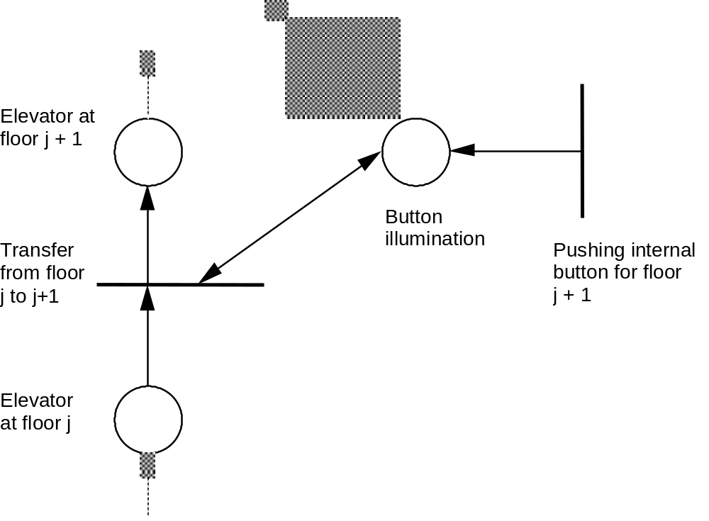
Initial sketch of movement

Slide 71
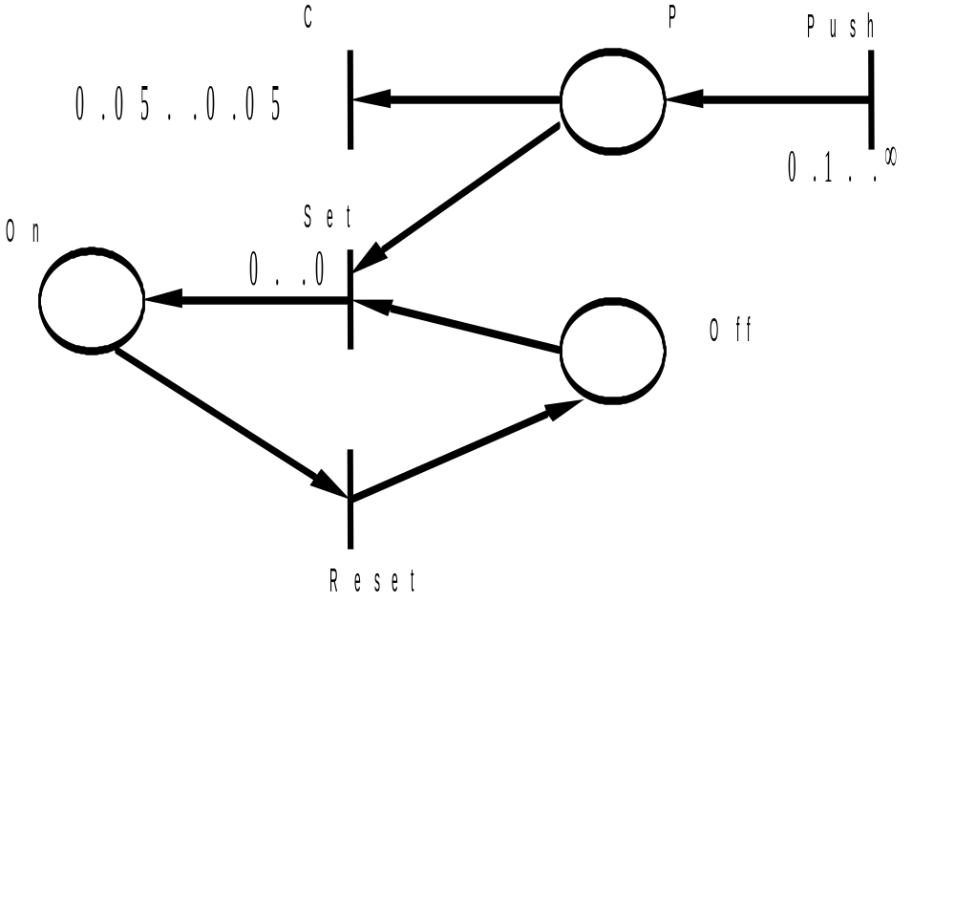
Button module

Slide 72
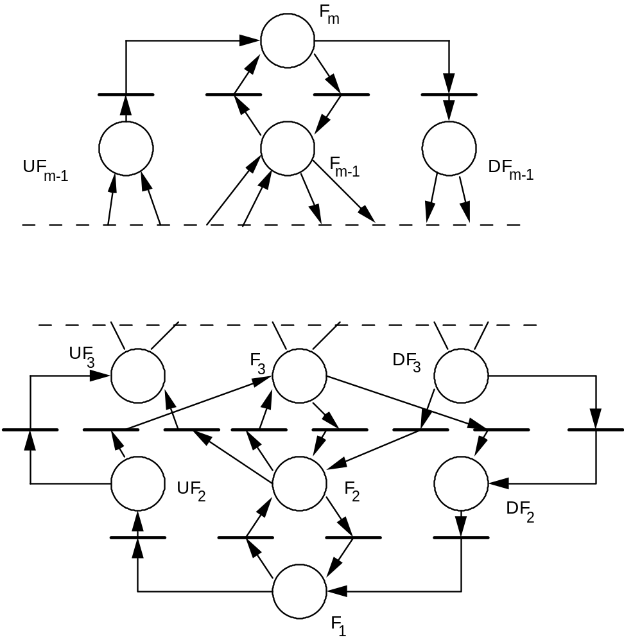
Elevator position (sketch)

Slide 73
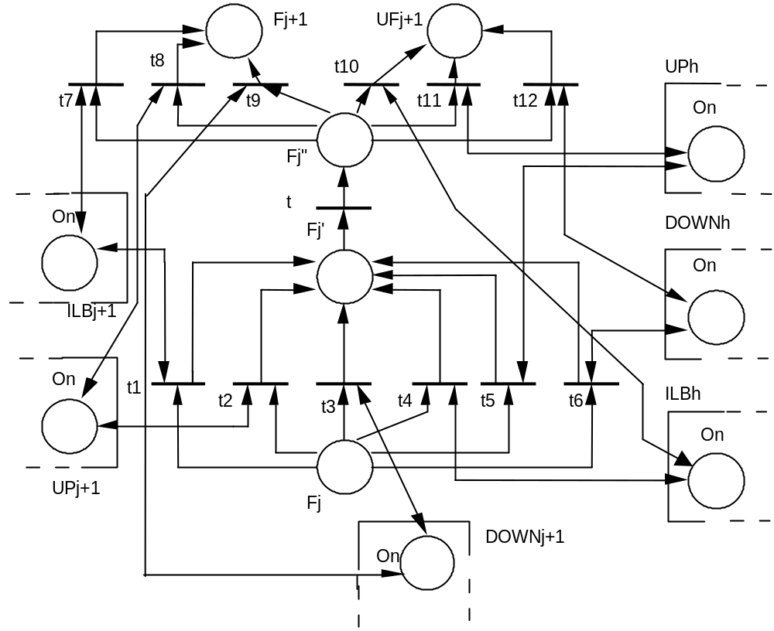
More precise description of elevator position
Assume j+1<h≤m

Slide 74
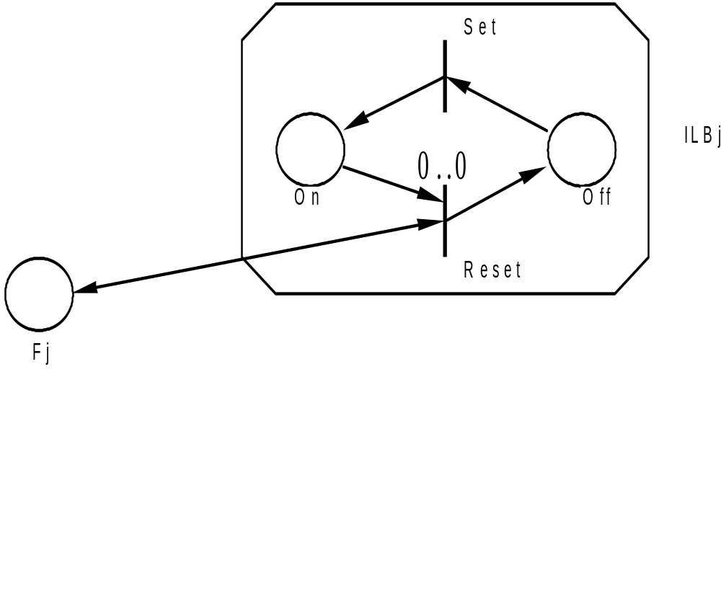
Switch internal button off

Slide 75
Switch external button off
Fj'
UPj
Set
ti
'
Fj
On
Off
x
..x
Reset
x time needed by
a person to enter + pushing button

Slide 76
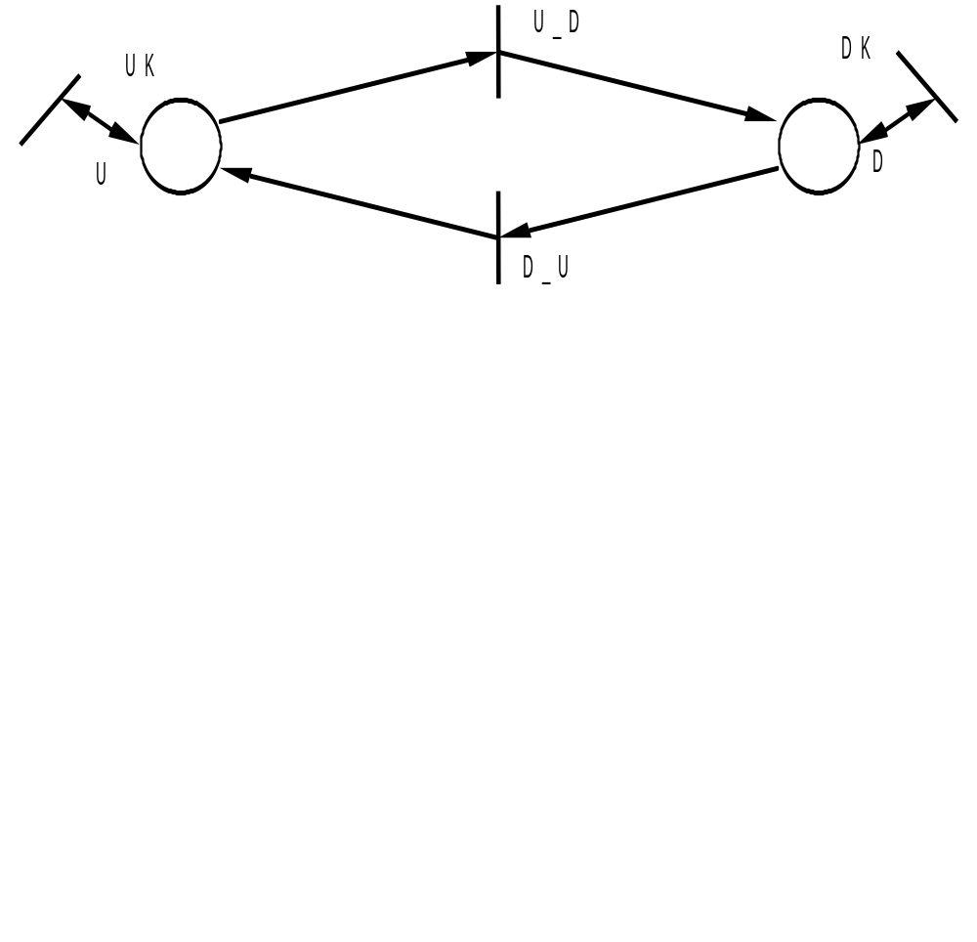
Specifying policy
A “fair” solution:
Keep the direction unchanged as long as there are
calls that require elevator to go in that direction
[x,x]
[0,0]
[0,0]
[x,x]
t7, t8, t9 have higher priority than t10, t11, t12

Slide 77
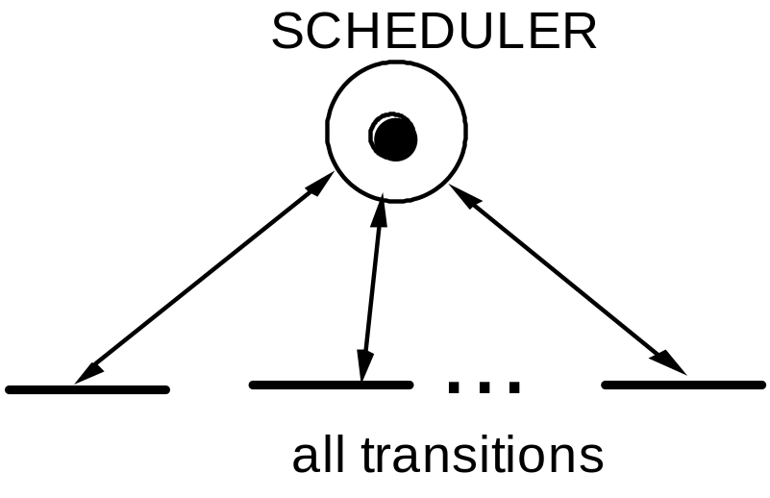
A general scheduler
Each transition has predicate OK(Scheduler)
Token in SCHEDULER stores information about the state of the system that is useful for scheduling transitions to fire
The token is “permanent” (it is always reproduced after the firing of any transition)

Slide 78
Declarative specifications
ER diagrams: semiformal specs
Logic specifications
Algebraic specifications

Slide 79
ER diagrams
Often used as a complement to DFD to describe conceptual data models
Based on entities, relationships, attributes
They are the ancestors of class diagrams in UML

Slide 80
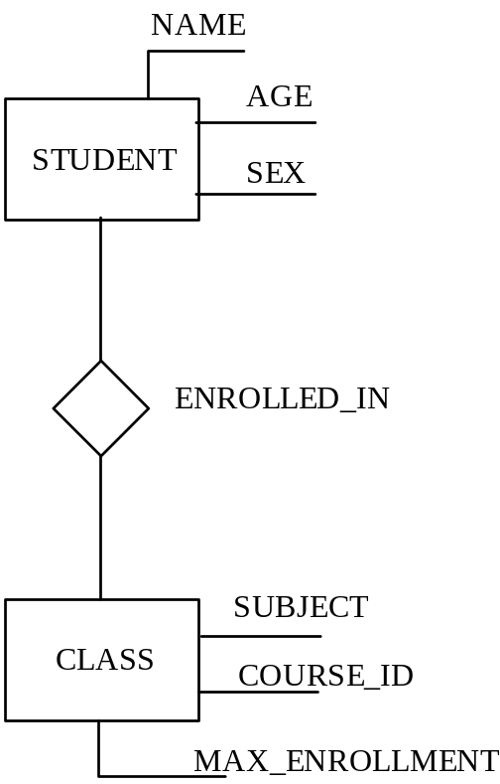
Example

Slide 81
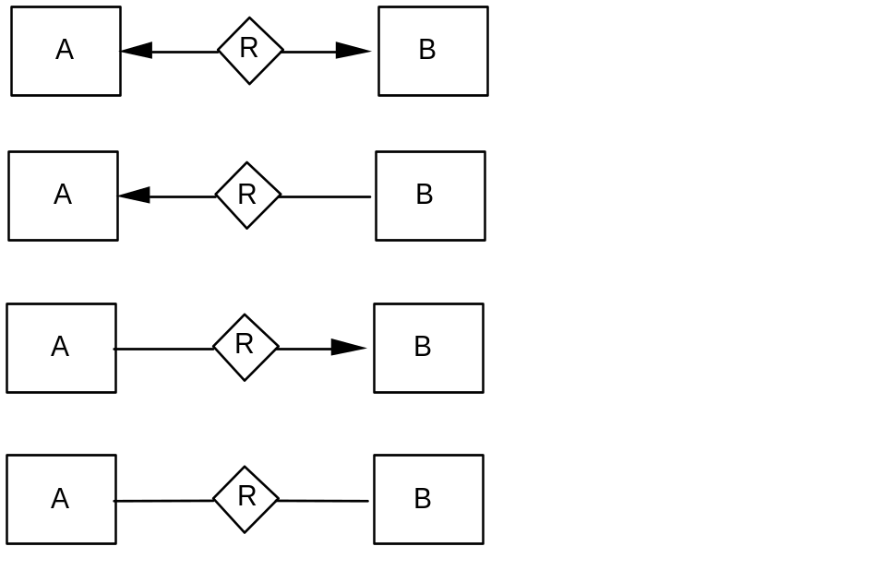
Relations
Relations can be partial
They can be annotated to define
  one to one
  one to many
  many to one
  many to many

Slide 82
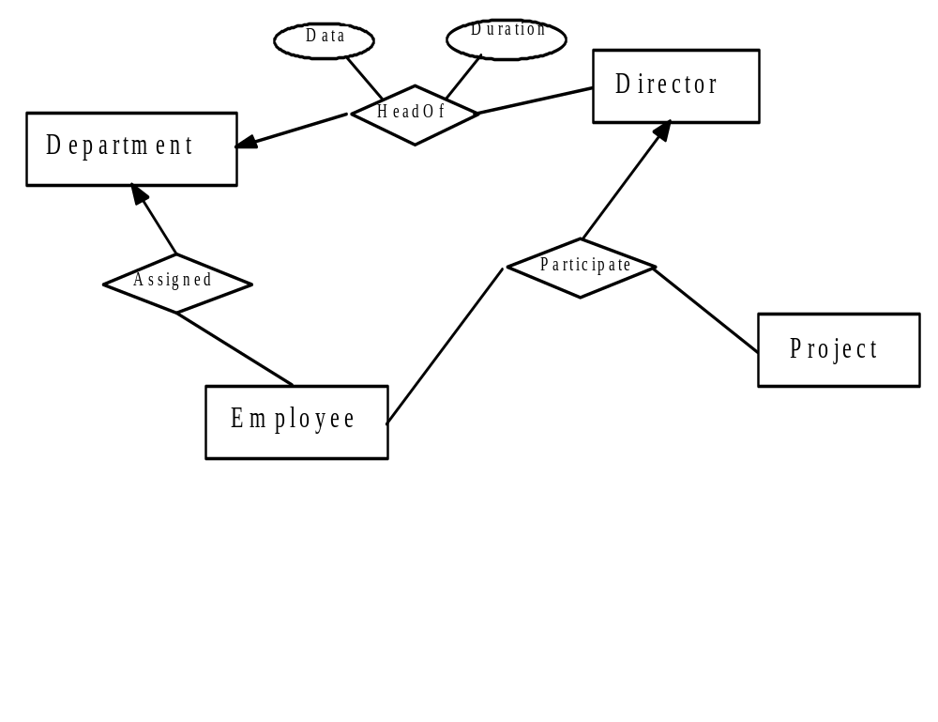
Non binary relations

Slide 83
Logic specifications
Examples of first-order theory (FOT) formulas:
x > y and y > z implies x > z
x = y ≡ y = x
for all x, y, z (x > y and y > z implies x > z)
x + 1 < x – 1
for all x (exists y (y = x + z))
x > 3 or x < -6

Slide 84
Specifying complete programs
A property, or requirement, for P is specified as a formula of the type
{Pre (i1, i2,..., in) }
P
{Post (o1, o2,..., om, i1, i2,..., in)}
Pre: precondition
Post: postcondition

Slide 85
Example
Program to compute greatest common divisor
{i1 > 0 and i2 > 0}
P
{(exists z1, z2 (i1 = o * z1 and i2 = o * z2)
and not (exists h
(exists z1, z2 (i1 = h * z1 and i2 = h * z2) and h > o))}

Slide 86
Specifying procedures
{n > 0} -- n is a constant value
procedure search (table: in integer_array; n: in integer;
element: in integer; found: out Boolean);
{found ≡ (exists i (1 ≤ i ≤ n and table (i) = element))}
{n > 0 }
procedure reverse (a: in out integer_array; n: in integer);
{for all i (1≤ i ≤ n) implies (a (i) = old–a (n - i +1))}

Slide 87
Specifying classes
Invariant predicates and pre/post conditions for each method
Example of invariant specifying an array implementing ADT set
for all i, j (1 ≤ i ≤ length and 1 ≤ j ≤ length and i≠j)
implies IMPL[i]≠IMPL[j]
(no duplicates are stored)

Slide 88
Specifying non-terminating behaviors
Example: producer+consumer+buffer
Invariant specifies that whatever has been produced is the concatenation of what has been taken from the buffer and what is kept in the buffer
input_sequence = append (output_sequence,
contents(CHAR_BUFFER))

Slide 89
A case-study using logic specifications
We outline the elevator example
Elementary predicates
  at (E, F, T)
    E is at floor F at time T
  start (E, F, T, up)
    E left floor F at time T moving up
Rules
  (at (E, F, T) and on (EB, F₁, T) and F₁ > F) implies start (E, F, T, up)

Slide 90
States and events
Elementary predicates are partitioned into
  states, having non-null duration
      standing(E, F, T1, T2)
        assumption: closed at left, open at right
  events
    instantaneous (caused state change occurs at same time)
    represented by predicates that hold only at a particular time instant
      arrived (E, F, T)
For simplicity, we assume
    zero decision time
    no simultaneous events

Slide 91
Events (1)
arrival (E, F, T)
  E in [1..n], F in [1..m], T ≥ t₀, (t₀ initial time)
    does not say if it will stop or will proceed, nor where it comes from
departure(E, F, D, T)
  E in [1..n], F in [1..m], D in {up, down}, T ≥ t₀
stop (E, F, T)
  E in [1..n], F in [1.. m], T ≥ t₀
    specifies stop to serve an internal or external request

Slide 92
Events (2)
new_list (E, L, T)
  E in [1..n], L in [1.. m]*, T ≥ t₀
    L is the list of floors to visit associated with elevator (scheduling is performed by the control component of the system)
call(F, D, T)
  external call (with restriction for 1, N)
request(E, F, T)
  internal reservation

Slide 93
States
moving (E, F, D, T1, T2)
standing (E, F, T1, T2)
list (E, L, T1, T2)
  We implicitly assume that state predicates hold for any sub- interval (i.e., the rules that describe this are assumed to be automatically added)
    Nothing prevents that it holds for larger interval

Slide 94
Rules relating events and states
R₁:When E arrives at floor F, it continues to move if there is
no request for service from F and the list is empty.
If the floor to serve is higher, it moves upward;
otherwise it moves downward.
arrival (E, F, T_{a}) and
list (E, L, T, T_{a}) and
first (L) > F
implies
departure (E, F, up, T_{a})
A similar rule describes downward movement.

Slide 95
R2: Upon arrival at F, E stops if F must be serviced (F
appears as first of the list)
arrival (E, F, T_{a}) and
list (E, L, T, T_{a}) and
first (L) = F
implies
stop (E, F,T_{a})
R3: E stops at F if it gets there with an empty list
arrival (E, F, T_{a}) and
list (E, empty, T, T_{a})
implies
stop (E, F, T_{a})

Slide 96
R4: Assume that elevators have a fixed time to service a floor.
If the list is not empty at the end of such interval,
the elevator leaves the floor immediately.
stop (E, F, T_{a}) and
list (E, L, T, T_{a} + Dt_{s}) and
first (L) > F,
implies
departure (E, F, up, T_{a} + Dt_{s}
R5: If the elevator has no floors to service, it stops until its
list becomes nonempty.
stop (E, F, T_{a}) and list (E, L, T_{p}, T) and
T_{p} > T_{a} + Dt_{s} and list (E, empty, T_{a} + Dt_{s}, T_{p}) and
first (L) > F
implies
departure (E, F, up, T_{p})

Slide 97
R6: Assume that the time to move from on floor to the
next is known and fixed. The rule describes movement.
departure (E, F, up, T)
implies
arrival (E, F + 1, T + Dt)
R7: The event of stopping initiates standing for at least Dts.
stop (E, F, T)
implies
standing (E, F, T, T + Dt_{s})

Slide 98
R8: At the end of the minimum stop interval Dts, E remains
standing if there are no floors to service.
stop (E, F, T_{s}) and
list (E, empty, T_{s} + Dt_{s}, T)
implies
standing (E, F, T_{s}, T)
R9: Departure causes moving.
departure (E, F, D, T)
implies
moving (E, F, D, T, T + Dt)

Slide 99
Control rules
Express the scheduling strategy (by describing “new_list”
events and “list” states)
Internal requests are inserted in the list from current
floor to top if the elevator is moving up
External calls are inserted in the list of the closest elevator
that is moving in the correct direction, or in a standing
elevator

Slide 100
R10: Reserving F from inside E, which is not standing at F,
causes immediate update of L according to previous policy
request (E, F, T_{R}) and not (standing (E, F, T_{a}, T_{R})) and
list (E, L, T_{a}, T_{R}) and LF = insert_in_order(L, F, E)
implies
new_list (E, LF, T_{R})

Slide 101
R11: Effect of arrival of E at floor F
arrival (E, F, T_{a}) and list (E, L, T, T_{a}) and
F = first (L) and L_{t} = tail (L)
implies
new_list (E, L_{t}, T_{a})
R12: How list changes
new_list (E, L, T₁) and not (new_list (E, L, T₂) and
T₁ < T₂ < T₃)
implies
list (E, L, T₁, T₃)

Slide 102
Verifying specifications
The system can be simulated by providing a state (set of facts) and using rules to make deductions
  standing (2, 3, 5, 7) elevator 2 at floor 3 at least from instant 5 to 7
  list(2, empty, 5, 7)
  request(2, 8, 7)
  new_list(2, {8}, 7)
⇒ (excluding other events)
departure (2, up, 7 + Dt_{s})
arrival (2, 8, 7 + Dt_{s} + Dt_{a} *(8-3))

Slide 103
Verifying specifications
Properties can be stated and proved via deductions
new_list (E, L, T) and F ∈ L
implies
new_list (E, L₁, T₁) and F ∉ L₁ and T₁ > T₂
(all requests are served eventually)

Slide 104
Descriptive specs
The system and its properties are described in the same language
Proving properties, however, cannot be fully mechanized for most languages

Slide 105
Algebraic specifications
Define a heterogeneous algebra
Heterogeneous = more than 1 set
Especially useful to specify ADTs

Slide 106
Example
A system for strings, with operations for
  creating new, empty strings (operation new)
  concatenating strings (operation append)
  adding a new character at the end of a string (operation add)
  checking the length of a given string (operation length)
  checking whether a string is empty (operation isEmpty)
  checking whether two strings are equal (operation equal)

Slide 107
Specification: syntax
algebra StringSpec;
introduces
sorts String, Char, Nat, Bool;
operations
new: ()→ String;
append: String, String → String;
add: String, Char → String;
length: String → Nat;
isEmpty: String → Bool;
equal: String, String → Bool

Slide 108
Specification: properties
constrains new, append, add, length, isEmpty, equal so that
for all [s, s1, s2: String; c: Char]
isEmpty (new ()) = true;
isEmpty (add (s, c)) = false;
length (new ()) = 0;
length (add (s, c)) = length (s) + 1;
append (s, new ()) = s;
append (s1, add (s2,c)) = add (append (s1,s2),c);
equal (new (),new ()) = true;
equal (new (), add (s, c)) = false;
equal (add (s, c), new ()) = false;
equal (add (s1, c), add (s2, c) = equal (s1,s2);
end StringSpec.

Slide 109
Example: editor
newF
  creates a new, empty file
isEmptyF
  states whether a file is empty
addF
  adds a string of characters to the end of a file
insertF
  inserts a string at a given position of a file (the rest of the file will be rewritten just after the inserted string)
appendF
  concatenates two files

Slide 110
algebra TextEditor;
introduces
sorts Text, String, Char, Bool, Nat;
operations
      newF: ()→ Text;
      isEmptyF: Text → Bool;
      addF: Text, String → Text;
      insertF: Text, Nat, String → Text;
      appendF: Text, Text → Text;
      deleteF: Text → Text;
      lengthF : Text → Nat;
      equalF : Text, Text → Bool;
      addFC: Text, Char → Text;
{This is an auxiliary operation that will be needed
to define addF and other operations on files.}

Slide 111
constrains newF, isEmptyF, addF, appendF, insertF, deleteF
so that TextEditor generated by [newF, addFC]
for all [f, f1,f2: Text; s: String; c: Char; cursor: Nat]
isEmptyF (newF ()) = true;
isEmptyF (addFC (f, c)) = false;
addF (f, newS ()) = f;
addF (f, addS (s, c)) = addFC (addF (f, s), c);
lengthF (newF ()) = 0;
lengthF (addFC (f, c)) = lengthF (f) + 1;
appendF (f, newF ()) = f;
appendF (f1, addFC (f2, c)) =
addFC (appendF (f1, f2), c);
equalF (newF (),newF ()) = true;
equalF (newF (), addFC (f, c)) = false;
equalF (addFC (f, c), new ()) = false;
equalF (addFC (f1, c1), addFC (f2, c2) =
equalF (f1, f2) and equalC (c1, c2);
insertF (f, cursor, newS ()) = f;
((equalF (f, appendF (f1, f2)) and (lengthF (f1) = cursor - 1))
implies
equalF (insertF (f, cursor, s), appendF (addF (f1, s), f2))) = true;
end TextEditor.

Slide 112
Requirements for a notation
Ability to support separation of concerns
  e.g., separate functional specs from
    performance specs
    user-interface specs
    …
Support different views

Slide 113
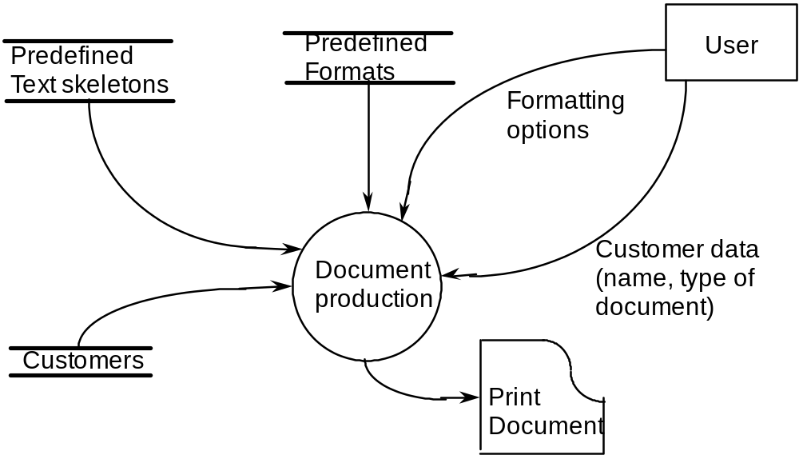
Example of views document production
data flow view (1)

Slide 114
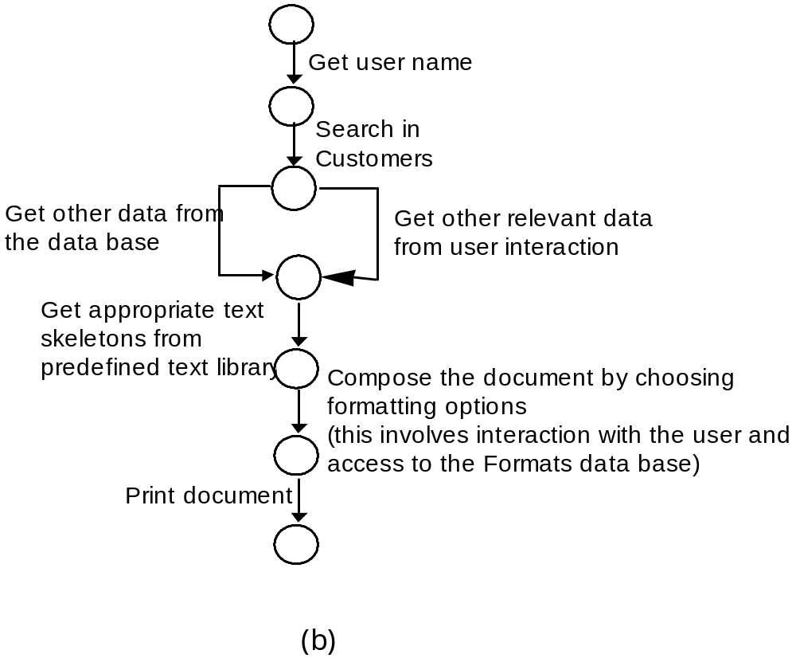
Control flow view (2)

Slide 115
UML notations
Class diagrams
  describe static architecture in terms of classes and associations
  dynamic evolution can be described via Statecharts (see later)
Activity diagrams
  describe sequential and parallel composition of method executions, and synchronization

Slide 116
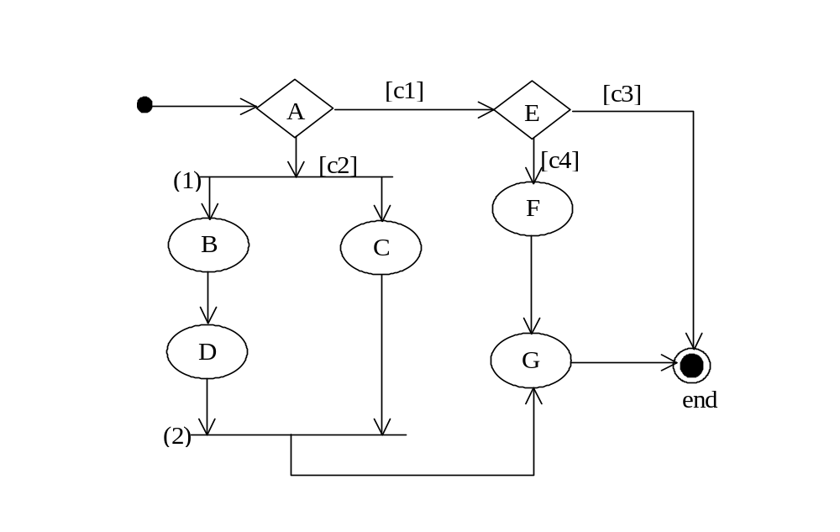
An activity diagram

Slide 117
Building modular specifications
The case of algebraic specifications
  How to combine algebras taken from a library
  How to organize them in a hierarchy

Slide 118
Algebras used by StringSpec
algebra BoolAlg;
introduces
sorts Bool;
operations
        true () → Bool;
        false () → Bool;
        not : Bool → Bool;
        and: Bool, Bool → Bool;
        or: Bool, Bool → Bool;
        implies: Bool, Bool → Bool;
        ≡ : Bool, Bool → Bool;
constrains true, false, not, and, or, implies, ≡ so that
Bool generated by [true, false]
for all [a, b: Bool]
  not (true) = false;
  not (false) = true;
  a and b = not (not (a) or not (b));
  a implies b = not (a) or b;
…
end BoolAlg.

Slide 119
Algebras used by StringSpec (cont.)
algebra NatNumb;
introduces
sorts Nat, Bool;
operations
      0: () → Nat;
      Succ: Nat → Nat;
      + : Nat, Nat → Nat;
      - : Nat, Nat → Nat;
      = : Nat, Nat → Bool;
…
constrains 0, Succ, +, -, =,..., so that
NatNumb generated by [0, Succ]
…
end NatNumb.
algebra CharAlg;
introduces
sorts Char, Bool;
operations
‘a’: ()® Char;
‘b’ : ()® Char;
…
end CharAlg.

Slide 120
StringSpec revisited
algebra StringSpec;
imports BoolAlg, NatNumb, CharAlg;
introduces
sorts String, Char, Nat, Bool;
operations
new: () → String;
…
end StringSpec.

Slide 121
Incremental specification of an ADT
We want to target stacks, queues, sets
We start from "container" and then progressively specialize it
We introduce another structuring clause
  assumes
    defines inheritance relation among algebras

Slide 122
Container algebra
algebra Container;
imports DataType, BoolAlg, NatNumb;
introduces
sorts Cont;
operations
new: () → Cont;
insert: Cont, Data → Cont;
{Data is the sort of algebra DataType, to which
elements to be stored in Cont belong}
isEmpty: Cont → Bool;
size: Cont → Nat;
constrains new, insert, isEmpty, size so that
Cont generated by [new, insert]
for all [d: Data; c: Cont]
isEmpty (new ()) = true;
isEmpty (insert (c, d)) = false;
size (new ()) = 0;
end Container.

Slide 123
Table specializes Container
algebra TableAlg;
assumes Container;
introduces
sorts Table;
operations
last: Table → Data;
rest: Table → Table;
equalT : Table, Table → Bool;
delete: Table, Data → Table;
constrains last, rest, equalT, delete, isEmpty, new, insert so that
for all [d, d1, d2: Data; t, t1, t2: Table]
last (insert (t, d)) = d;
rest (new ()) = new ();
rest (insert (t, d)) = t;
equalT (new (), new ()) = true;
equalT (insert (t, d), new ()) = false;
equalT (new (), insert (t,d)) = false;
equalT (t1,t2) = equalD(last (t1), last (t2)) and
equalT (rest (t1),rest (t2));
delete (new (), d) = new ();
delete (insert (t,d),d) = delete (t, d);
if not equalD(d1, d2) then
delete (insert (t, d1), d2) = insert (delete (t, d2), d1);
end TableAlg.

Slide 124
Queue specializes Container
algebra QueueAlg;
assumes Container;
introduces
sort Queue;
operations
last: Queue → Data;
first: Queue → Data;
equalQ : Queue , Queue → Bool;
delete:Queue → Queue;
constrains last, first, equalQ, delete, isEmpty, new, insert so that
for all [d: Data; q, q1, q2: Queue]
last (insert (q, d)) = d;
first (insert (new(), d) = d
first (insert (q, d)) = if not isEmpty (q) then first (q);
equalQ (new (), new ()) = true;
equalQ (insert (q, d), new ()) = false;
equalQ (new (), insert (q, d)) = false;
equalQ (insert (q1, d1), insert (q2, d2)) = equalD (d1, d2) and
equalQ (q1,q2);
delete (new ()) = new ();
delete (insert (new (), d)) = new ();
if not equalQ (q, new ()) then
delete (insert (q,d)) = insert (delete (q), d);
end QueueAlg.

Slide 125
A graphical view
Queue
Table
Algebra
Algebra
Container
Algebra
Bool
Nat
Algebra
Algebra
DataType
Algebra
Legend:
imports
relation
assumes
relation

Slide 126
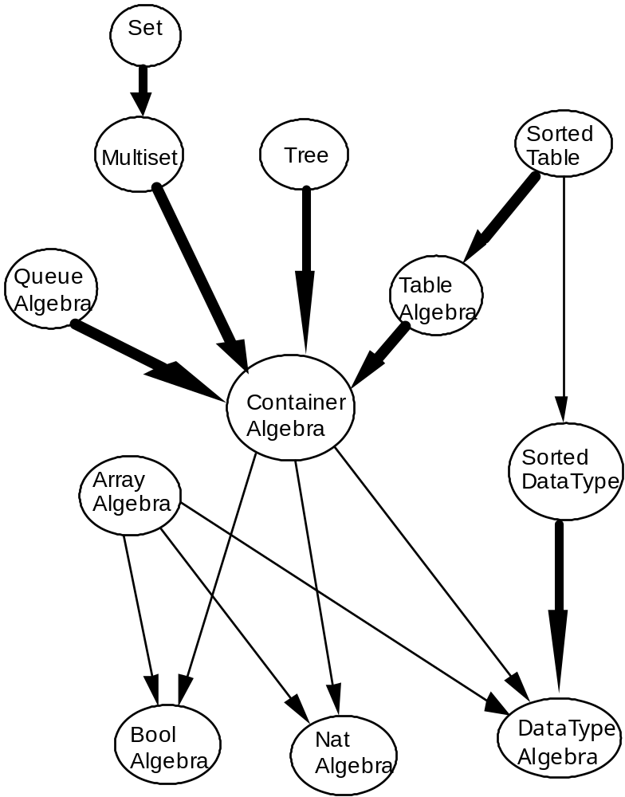
A richer hierarchy

Slide 127
From specs to an implementation
Algebraic spec language described so far is based on the "Larch shared language"
Several "interface languages" are available to help transitioning to an implementation
  Larch/C++, Larch/Pascal

Slide 128
Using Larch/Pascal for StringSpec
type String exports isEmpty, add, append,...
based on Boolean, integer, character
function isEmpty (s: String) : Boolean
modifies at most [ ] {i.e., it has no side effects};
procedure add (var s : String; c : char)
modifies at most [s]
{modifies only the string parameter s};
function length (s: String) : integer
modifies at most [ ] ;
procedure append (var s1, s2, s3: string)
modifies at most [s3]
{only s3, the result of the operation, is modified};
end StringSpec.

Slide 129
Modularizing finite state machines
Statecharts do that
They have been incorporated in UML
They provide the notions of
  superstate
  state decomposition

Slide 130

Sequential decomposition
--chemical plant control example--

Slide 131

Parallel decomposition

Slide 132
Object state diagram using Statecharts
Top
Push(item)
Empty
NotEmpty
Pop[stack contains 1 item]
y
Push(item)
Pop[stack contains more than 1 item]

Slide 133
Modularizing logic specifications: Z
System specified by describing state space, using Z shemas
Properties of state space described by invariant predicates
  predicates written in first-order logic
Operations define state transformations

Slide 134

The elevator example in Z

Slide 135

Complete state space attempt #1

Slide 136

Complete state space attempt #2

Slide 137

Complete state space final

Slide 138

Operations
(1)

Slide 139

Operations
(2)

Slide 140
Specifications for the end-user
Specs should be used as common reference for producer and user
They help removing ambiguity, incompleteness, …
Can they be understood by end-user?
  They can be the starting point for a prototype
  They can support some form of animation (e.g., see Petri nets)

Slide 141
Conclusions (1)
Specifications describe
  what the users need from a system (requirements specification)
  the design of a software system (design and architecture specification)
  the features offered by a system (functional specification)
  the performance characteristics of a system (performance specification)
  the external behavior of a module (module interface specification)
  the internal structure of a module (internal structural specification)

Slide 142
Conclusions (2)
Descriptions are given via suitable notations
  There is no “ideal” notation
They must be modular
They support communication and interaction between designers and users

